Slide 1

21 July 2026

Slide 2
Outline
Media Access Control
  Controlled Access
  Contention Access
Error Control
  Prevent
  Detect
  Correct
Protocols
  Message Delineation
  Ethernet
  PPP

Slide 3
Data Link Layer
Internet Model
Layer 2 in the Internet model
Responsible for moving messages from one device to another
Controls the way messages are sent on media
Organizes layer 1 bit streams into coherent messages for the network layer
Major functions of a data link layer protocol
  Media Access Control
  Error Control
  Message Delineation
Transport
Network
Data Link
Physical
Application

Slide 4
Media Access Control
Controls which device transmits and when
Important on
  Multipoint (shared) circuits
  Half-duplex point-to-point circuits
Two approaches to control
  Contention access
  Controlled access

Slide 5
Contention
Situation in a network where two or more devices attempt to use the same communication channel (medium) at the same time.
  Transmit whenever a circuit is available, with no centralized control
  Common in Ethernet LANs
Notes:
Imagine 5 people in a meeting trying to speak at the same time

Slide 6
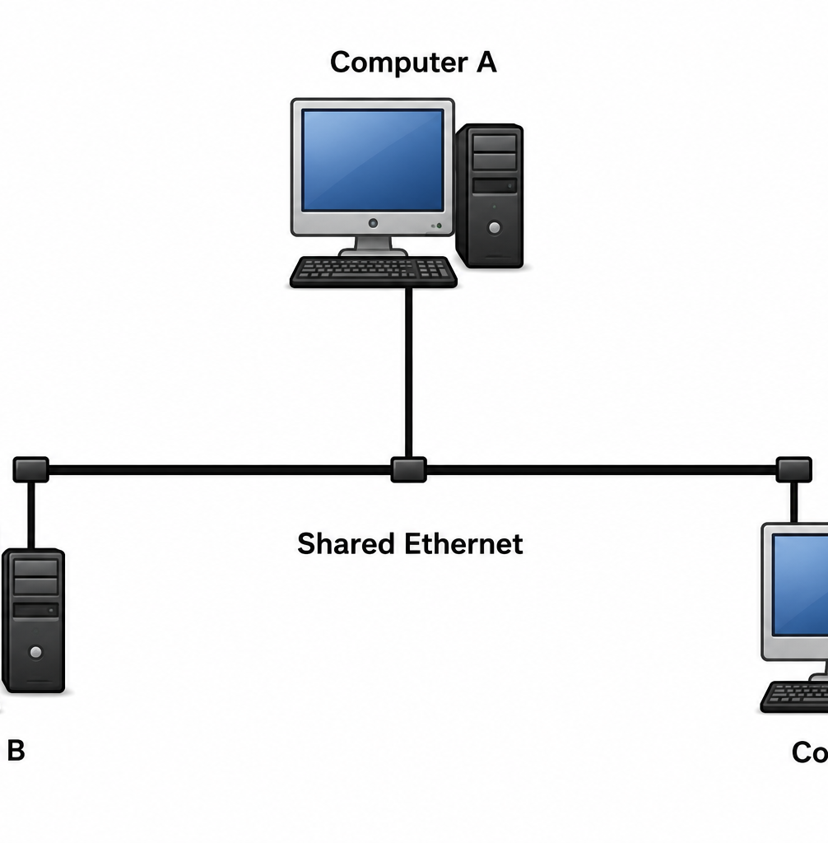
Example
Suppose three computers are connected to the same Ethernet network
Computer A & B wants to send data
Both compete for the same cable
If they transmit simultaneously, a collision occurs
Both computers stop transmitting
Wait for a random amount of time & try again
Notes:
At this competition, the transmission medium is called contention

Slide 7
Example in Wi-Fi
With wireless networks:
  Several devices may want to send data to the wi-fi access point (simultaneously)
  They first listens to determine whether the channel is free
  If the channel is busy, they wait for a random period & try again
  This reduces the chance of 2 devices transmitting at the same time

Slide 8
Controlled Access
Is a MAC method where a network controls which device is allowed to transmit at a given time, ensuring orderly comm. & reduce collisions.
How it works:
Device requests permission to transmit or waits for its turn
The network determines which device can send data
Only the authorized device transmits
After transmission, another device is granted access
Notes:
Because only one device transmits at a time, collisions are greatly reduced or completely avoided.

Slide 9
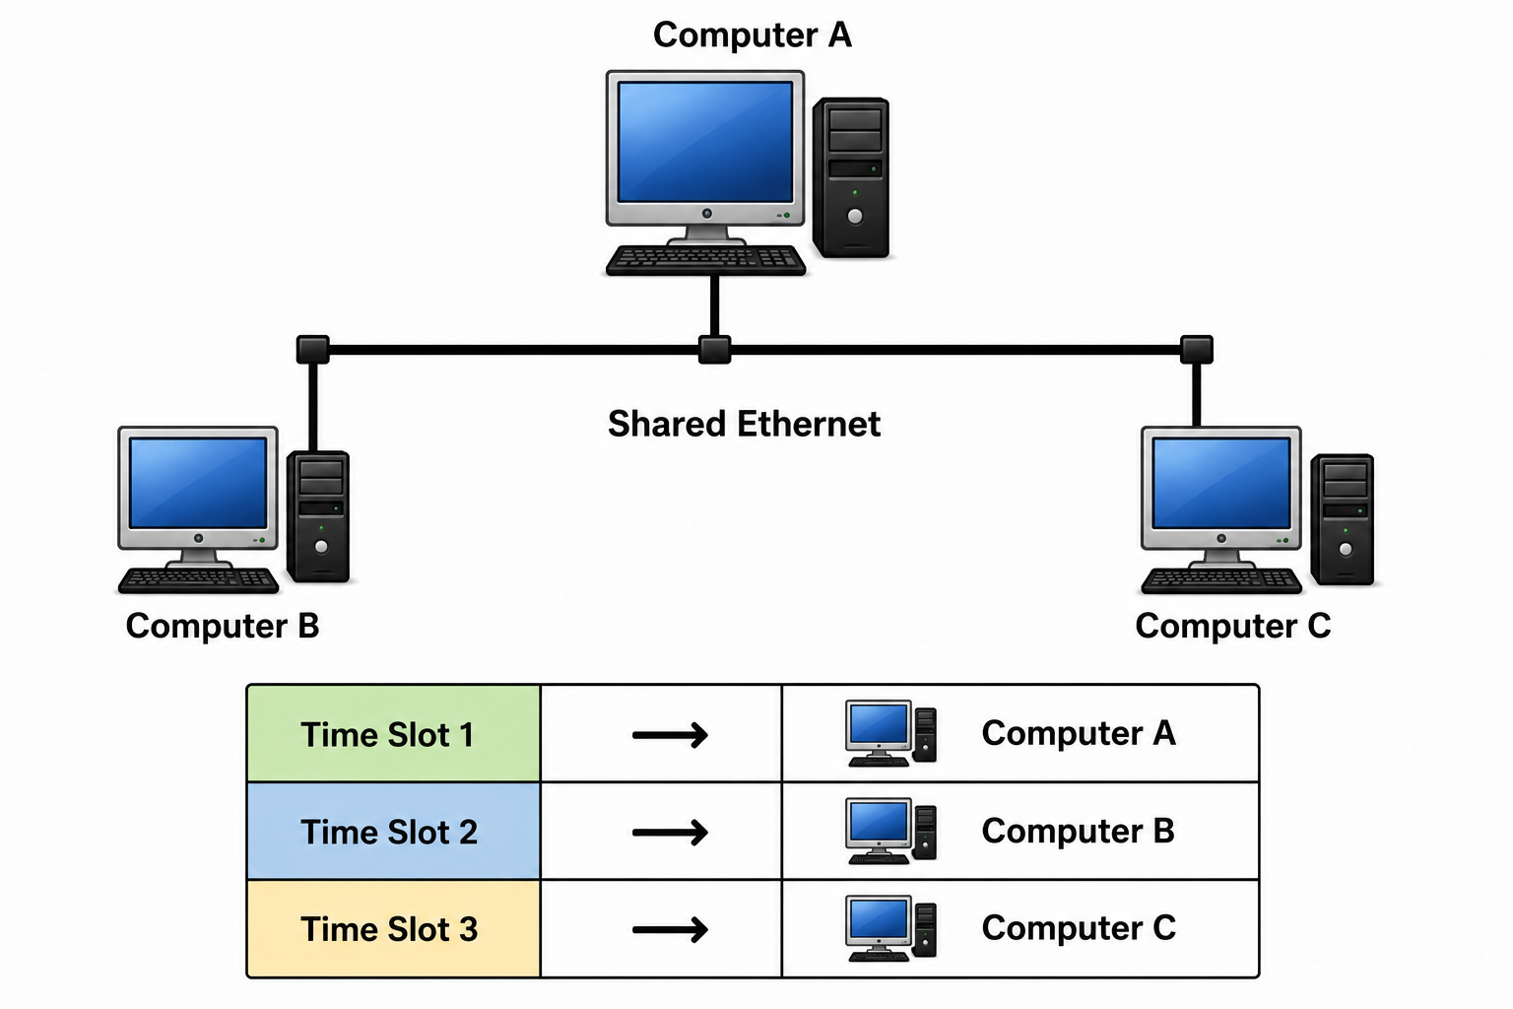
Types of controlled access
Reservation
  Device reserve time slots before transmitting
  Each device transmits only during its allocated time
  Common in satellite & cellular networks

Slide 10
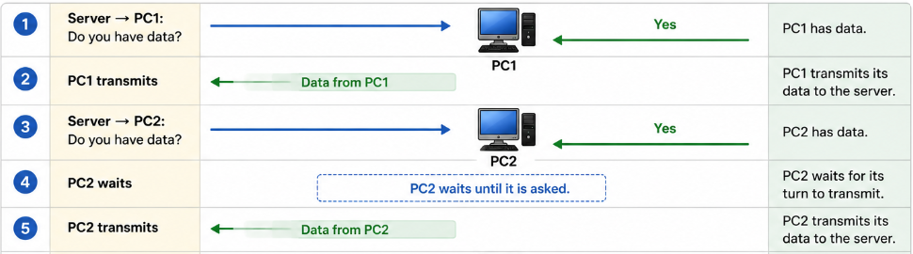
Polling
A central controller (master) asks each device in turn whether it has data to send
A device transmits only when it is polled
Notes:
Polling means the server asks one device at a time

Slide 11
Token passing
A special control frame called a token circulates around the network
Only the device holding the token is allowed to transmit
After transmitting, it passes the token to the next device
Notes:
Computer A → Token → Computer B → Token → Computer C
If Computer B has the token, only Computer B can send data

Slide 12
Advantages | Drawbacks
Prevents or greatly reduces collisions | More complex to implement than contention-based
Provides fair access to all devices | Introduce delays while waiting for permission or token
More efficient under heavy network traffic | Failure of the controller or token mechanism can affect commun

Slide 13

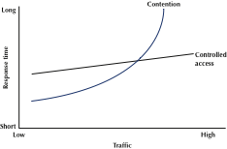
Media Access Control
With high traffic, controlled access is better because of the high collisions of contention.
With low traffic, the higher overhead of controlled access makes contention more efficient.
Cross-over point used to be 20 devices, but very much depends on devices, protocols, traffic, etc.

Slide 14
CSMA (Carrier Sense Multiple Access)
Requires each device to listen to the communication medium before transmitting.
Each host continuously monitors the network to determine whether another device is currently transmitting data.
If the channel is busy, the host waits until transmission is complete
If the channel is idle, the host begins transmitting its data frame
After a frame is transmitted, the network observes an Interframe gap (IFG)
Short waiting period enabling devices for next transmission
This approach reduces the likelihood of collisions
Notes:
We can improve the network performance by introducing carrier sensing (CS)

Slide 15
CSMA
Carrier Sense Multiple Access
  sense carrier
  if idle, send
  wait for ack
    If there isn’t one, assume there was a collision, retransmit

Slide 16
CSMA WITH COLLISION AVOIDANCE (CSMA/CA)
Medium access protocol used in wireless networks (IEEE 802.11 Wi-Fi)
Helps reduce the chance of data collisions
Requires devices to listen to the wireless channel before transmitting

Slide 17
How CSMA/CA works
Carrier sense
  Device listens to the wireless channel to determine whether (idle / busy)
Channel busy
  If device A transmitting, wait till channel is free
Random backoff
  Channel idle, wait random period (backoff time)
  Reduces chance that multiple devices begin transmission at exactly the same time.

Slide 18
Transmit Data
  After the backoff timer expires, the device transmits its data frame.
Acknowledgment (ACK)
  The receiver sends an ACK frame to confirm that the data was received successfully.
  If no ACK is received, the sender assumes the transmission failed and retransmits the frame.

Slide 19
Why CSMA/CA is Used in Wi-Fi?
In wireless networks, devices cannot detect collisions while they are transmitting because:
  They cannot transmit & listen at the same time
  Their own transmitted signal is much stronger than any incoming signal
  Unlike Ethernet, wifi avoids collisions instead of detecting them

Slide 20
Wireless 802.11 LAN
Uses CSMA/CA
Why CA and CD?
  Difficult to detect collisions in a radio environment – why?
  Hidden terminal Problem:
    Occurs in a wireless network when two devices cannot hear each other’s transmission
    Out of each other’s communication range
    But both can communicate with the same access point

Slide 21
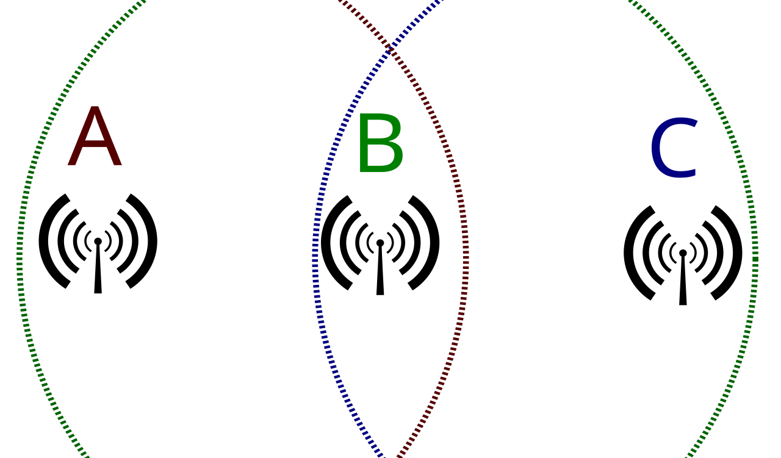
Hidden Terminal Problem
Notes:
-Computer A wants to send data to the Access Point.
Computer B also wants to send data to the Access Point.
Since A and B are too far apart, they cannot detect each other's transmissions.
Both believe the wireless channel is free and transmit simultaneously.
Their frames collide at the Access Point, resulting in lost data.

Slide 22
Why it happens
The hidden terminal problem occurs because:
  Wireless devices have a limited transmission range.
  Obstacles such as walls, buildings, or long distances can block signals.
  A device can only sense transmissions from devices within its range.

Slide 23
Solution: RTS/CTS Mechanism
How RTS/CTS Works:
The S sends an RTS (Request to Send) frame to the Access Point.
If the channel is available, the Access Point replies with a CTS (Clear to Send) frame.
All nearby devices that hear the CTS know the medium will be busy and wait.
The sender transmits its data.
The receiver sends an ACK after receiving the data successfully.

Slide 24
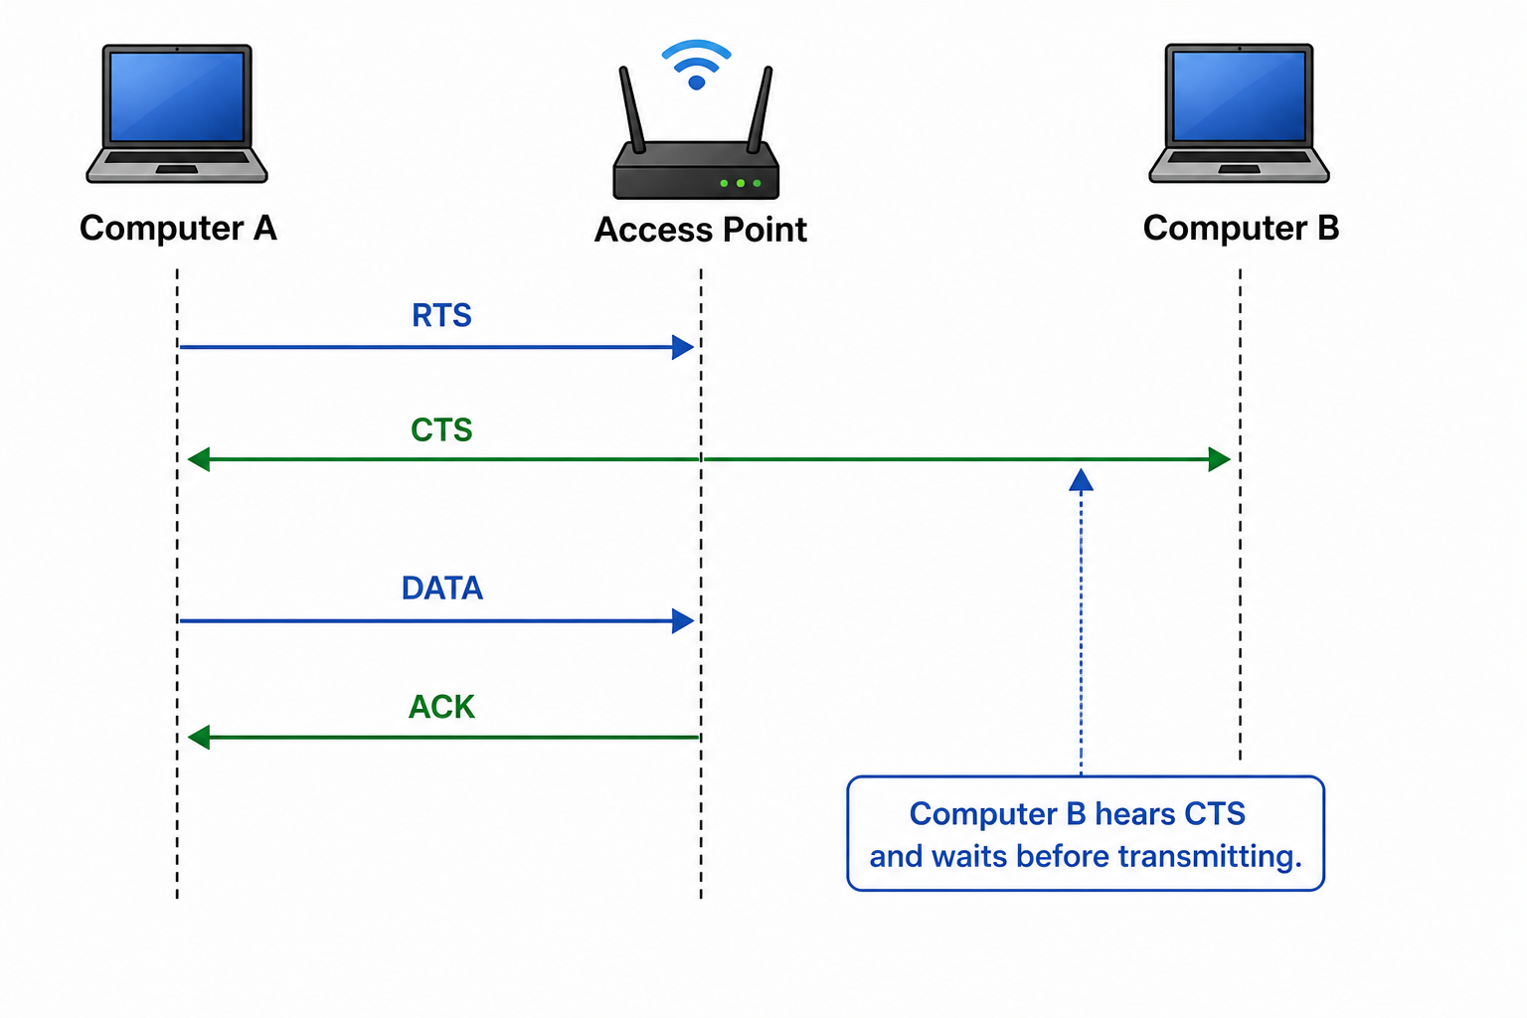

Slide 25
Challenge | Description
No Fate Sharing | Different devices experience different wireless channel conditions and reliability.
High Loss Rates | Wireless packets are more likely to be lost because of interference, fading, and obstacles.
Variable Channel Conditions | Signal quality changes over time due to movement, interference, and environmental factors.
Half-Duplex Radios | Wireless devices cannot transmit and receive simultaneously on the same channel.
Strong Transmit Signal | The transmitted signal is much stronger than received signals, preventing collision detection during transmission.

Slide 26
Why is it difficult to detect collisions in a radio environment?
A transmitting wireless station cannot effectively detect incoming weak signals.
The station’s own transmitted signal is much stronger than any incoming signal, overwhelming the receiver.
Weak incoming signals are often masked by noise
Wireless device cant reliably detect collisions during transmission.

Slide 27
Most wifi devices are half-duplex, cant transmit & receive at same time

Slide 28
What is CSMA/CD?
Network access control method used in traditional Ethernet networks
  Manage how devices share a channel
  Avoid or handle collisions
  Standard access method for half-duplex Ethernet
  (10 Mbps & 100 Mbps networks)

Slide 29
CSMA/CD: Some Details
When a sender detects a collision, it sends a “jam signal”.
  Make sure that all nodes are aware of the collision
  Length of the jam signal is 32 bit times
Exponential backoff operates in multiples of 512 bit times.
  Longer than a roundtrip time
  Guarantees that nodes that back off longer will notice the earlier retransmission before starting to send

Slide 30
Why Was CSMA/CD Needed?
Early ethernet networks (bus or hubs), all devices shared the same physical cable
If 2 devices transmitted at the same time
Their signals collided, corrupting the data
Thus, CSMA/CD provides rules to:
Listen before talking
Detect collisions
Recover from collisions efficiently

Slide 31
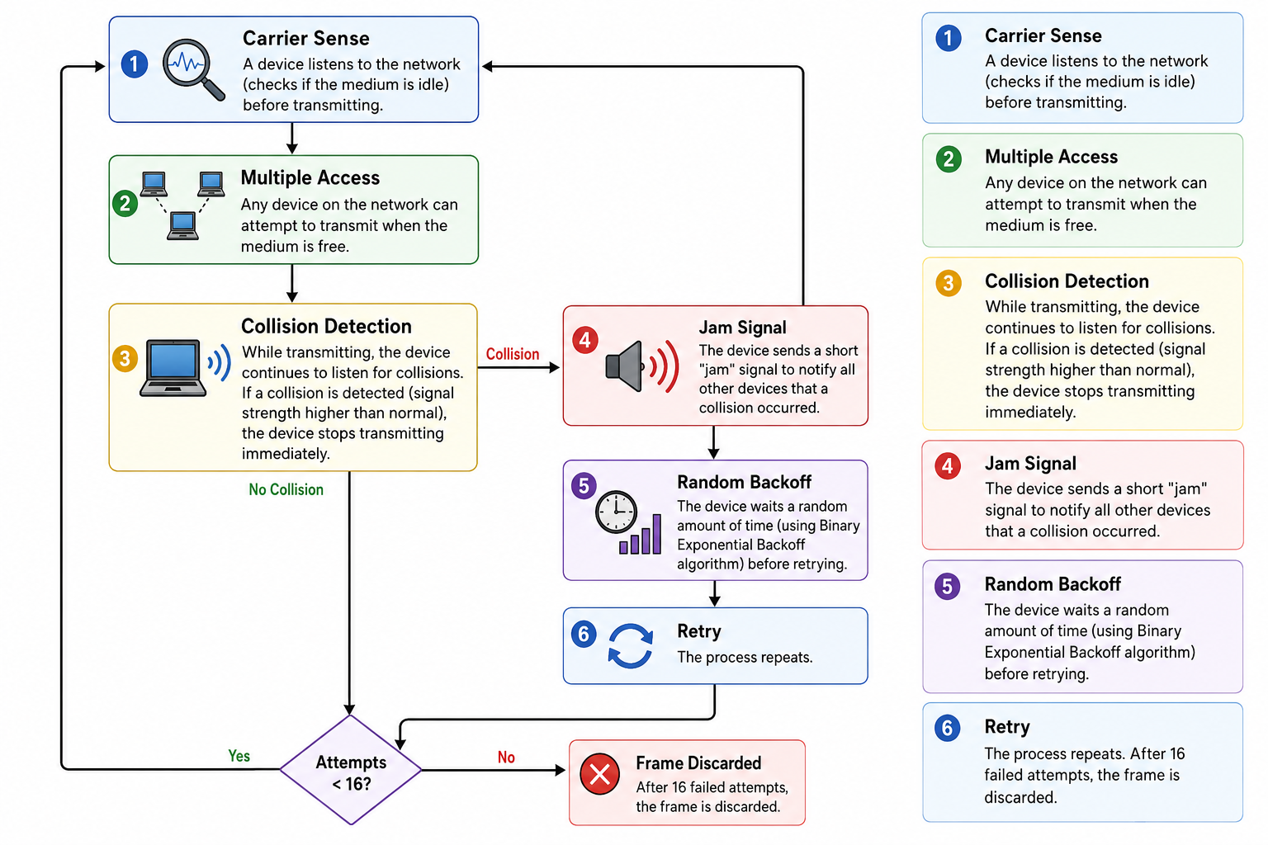

Slide 32
Error Control
Process of detecting & correcting errors occurred during transmissions
Ensure data is delivered accurately, reliably & without corruption
Typically retransmit the unacknowledged frames
Timer protects against lost acknowledgments

Slide 33
Sources of Network Errors
Source of Error | Description | Common Effect
Line Noise | Unwanted electrical signals | Bit errors
Attenuation | Signal weakens over distance | Data loss
Distortion | Signal changes shape or timing | Incorrect data
Crosstalk | Interference from nearby cables | Corrupted data
EMI | Interference from electrical devices | Signal degradation
RFI | Interference from radio signals | Communication errors
Faulty Hardware | Damaged cables or devices | Lost or corrupted packets
Congestion | Excessive network traffic | Delays and packet loss
Collisions | Simultaneous transmissions | Corrupted frames
Wireless Interference | Obstacles or competing wireless signals | Weak signal and retransmissions

Slide 34
Error Prevention
Techniques used to reduce transmission errors before they occur
Ensure data is transmitted accurately by reducing effects of
  Noise
  Interference
  Attenuation

Slide 35
Why is Error Prevention Important?
Improves data transmission reliability
Reduces the need for retransmissions
Increases network efficiency & performance
Maintains data integrity
Enhances communication quality

Slide 36
Example 1
A financial institution has recently connected its branch office to its headquarters using a high-speed network. Employees frequently transfer customer account information, process online transactions, and conduct video meetings with staff at the headquarters.
However, the network administrator notices that some transaction records are arriving with missing or incorrect information. Employees also report that online transactions take longer than expected because some data has to be resent. During video meetings, the audio occasionally breaks up and the video freezes. As a result, customers experience delays in receiving banking services.
Notes:
based on the scenario, explain why error prevention would be important in this network.

Slide 37
Error Prevention
Source of Error | What Causes It | How to Prevent or Fix
White Noise | Movement of electrons | Increase signal strength
Impulse Noise | Sudden increases in electricity (e.g., lightning) | Shield or move the wires
Cross-talk | Multiplexer guardbands too small or wires too close together | Increase the guardbands or move or shield the wires
Echo | Poor (misaligned) connections | Fix the connections or tune equipment
Attenuation | Gradual decrease in signal over distance | Use repeaters
Intermodulation noise | Signals from several circuits combine | Move or shield the wires

Slide 38
Error Detection
Receivers need to know when the data transmitted is not correct
Add “check value” (error detection value) to message
Check value produced by a mathematical formula
Message
Check Value

Slide 39

Error Detection
Sender calculates check value from the original data & sends it along with the data
Receiver calculates its own check value from the received data
Sender
Receiver
Message
Check Value
Message
Check Value
Mathematical Calculations
Mathematical Calculations
Notes:
To compared whether the calculated value matches the received check value
If value match, data is assumed to be error free
If not, an error is detected

Slide 40
Error Detection techniques
Parity Check
Add a single parity but to the data
The parity bit makes the total number of 1s either even (even parity) or odd ( odd parity)
Example:
Data: 10110011 number of 1s = 5 (odd)
Using even parity, add: parity bit = 1
Transmitted data will be 101100111
Receiver will count the number of 1s again

Slide 41
Benefits vs drawbacks
Benefits
  Simple
  Fast
  Low overhead
  Drawbacks
    Detects only single-bit errors
    Cannot detect many multiple-bit errors

Slide 42
Checksum
A numerical value calculated from the data to detect errors during transmission or storage.
Checksum is calculated from the binary data being transmitted
Suppose the sender has 1 16-bit message 10110011 01010101 instead of treating it as one long sequence
Divides it into 8-bit blocks
Block 1: 10110011
Block 2: 01010101

Slide 43
Convert each block into a number
10110011 decimal 179
01010101 decimal 85
Calculate the checksum
179 + 85 = 264
In real networking protocols such as TCP, UDP & IP addition is performed using 1’s complement arithmetic
Notes:
Think of a teacher adding students marks student A, B, C
The receiver:
Receives the data.
Performs the same checksum calculation.
Compares its result with the received checksum.
If they match → the data is assumed to be correct.
If they do not match → an error is detected.

Slide 44
Cyclic redundancy check (CRC)
Powerful error detection technique used to detect errors in transmitted or stored data
CRC uses binary polynomial division to generate a CRC value, attached to the data before transmission
  Can detect single-bit errors
  Double-bit errors
  Burst errors (multiple consecutive bit errors)
Notes:
Much more reliable than parity checking & checksums

Slide 45
CRC works
Suppose the sender wants to transmit:
Data = 1101011011
Both S & R agree on generator polynomial before comm
Generator = 10011
Generator acts like a divisor in binary division

Slide 46
Calculate CRC
The sender:
  Appends zeros to the end of the data
  Performs binary modulo-2 division (XOR)
  Obtains the remainder
  Suppose the remainder is CRC = 1010
  Sender appends the CRC to the original data
  Original data 1101011011
  CRC 1010
  Transmitted frame 11010110111010
Notes:
Widely used in Ethernet networks,
Wi-fi
USB
Bluetooth
CDs & DVDs
ZIP & PNG

Slide 47
Error Correction
Process of detecting & recovering from transmission errors
Ensure accurate data delivery
Ensure reliable communication
Maintains data integrity
Prevent corrupted data from being used

Slide 48
Error Correction Techniques
Two main approaches
  Retransmission (backward error correction)
  When R detects an error, requests S to transmit again
  Most common and simplest method of error correction
  Know as Backward Error Correction
  Because R communicates back to S requesting retrains.

Slide 49
Automatic Repeat reQuest (ARQ)
Protocol that automatically manages retransmissions using ACKs & timeouts
Types of ARQ
Stop and wait ARQ
Continuous ARQ (sliding window ARQ)
Forward error correction (FEC)
Notes:
How ARQ Works
Sender transmits a frame.
Receiver checks for errors.
If the frame is correct, the receiver sends an ACK (Acknowledgement).
If the frame is corrupted or lost, the receiver sends a NAK (Negative Acknowledgement) or the sender retransmits after a timeout.
The sender retransmits the frame.

Slide 50
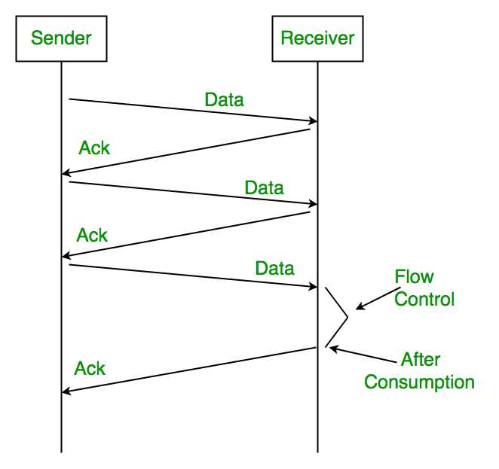
Stop-and-Wait ARQ
  If no ACK or NAK, Sender retransmits frame after “timeout”
  If no ACK, sender re-sends data, receiver sends ACK and deletes duplicate frame
ACK

Slide 51
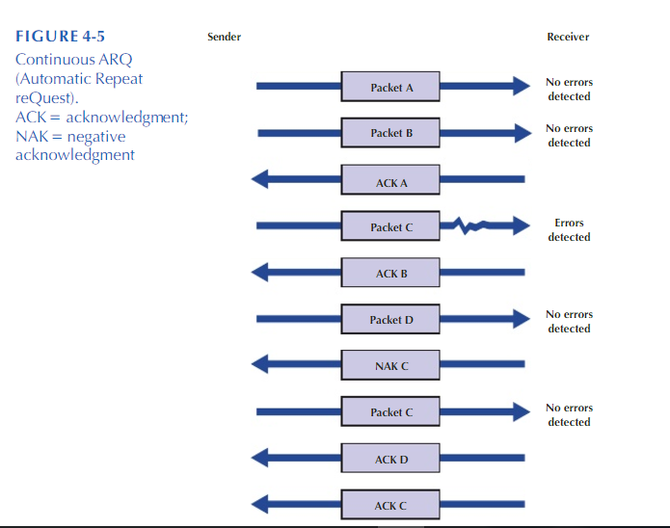
Continuous ARQ
  Sender does not wait for ACKs before sending more data
  “Sliding window” is number of frames allowed to be unacknowledged by receiver
  Agreed upon by sender and receiver
Notes:
flow control technique used in TCP allows a S to send data before receiving ACK

Slide 52
Forward Error Correction
  Includes redundant bits in the transmitted data
  Allows R to detect & correct errors without requesting original data again
  Don’t need retransmission
    Reduces communication delays
    Normally used when retransmission
      Impractical
      Expensive
      Introduce unacceptable delays
      Satellite communications, live & video streaming, real-time voice comm (VoIP)

Slide 53
Next slides: self-study

Slide 54
Data Link Protocols
Classification
  Asynchronous transmission
  Synchronous transmission
Protocols differ by
  Message delineation
  Frame length
  Frame field structure

Slide 55
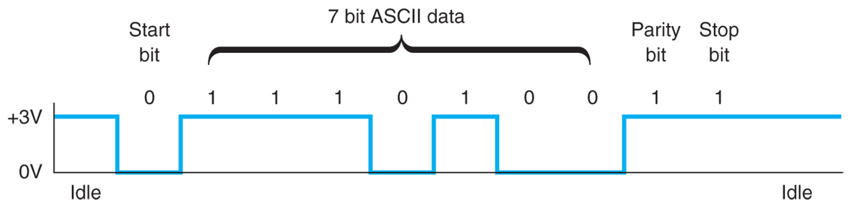
Data Link Protocols
Asynchronous serial transmission (async)
  Old protocol (e.g., used in teletype)
  Transmits one character at a time
  Delineation indicated by start and stop bits
Start Bit
(1 bit)
Message
(7 or 8 bits)
Parity
(1 bit)
Stop Bit
(1 bit)

Slide 56
Data Link Protocols
Synchronous transmission
  Data sent in a large block called a frame
  Includes addressing information
  Includes synchronization characters to let the receiver know when data transmission begins
  Example protocols: SDLC, HDLC, Ethernet, PPP

Slide 57
Data Link Protocols
Synchronous Data Link Control (SDLC)
  Synchronous bit-oriented protocol developed by IBM
  Uses bit stuffing (zero insertion) to overcome transparency problem
Flag
(8 bits)
Address
(8 bits)
Control
(8 bits)
Data
(variable)
CRC-32
(32 bites)
Flag
(8 bits)

Slide 58
Data Link Protocols
Ethernet
  IEEE 802.3 standard and Ethernet II
  Most widely used LAN protocol
  Uses contention media access control
  Ethernet II Frame
Interframe Gap
(12 bytes)
Preamble & Delimiter
(8 bytes)
Destination Address
(6 bytes)
Source Address
(6 bytes)
Type
(2 bytes)
Data
(46-1500 bytes)
CRC
(4 bytes)
38 Total Bytes of Overhead

Slide 59
Data Link Protocols
Point-to-point protocol (PPP)
  Common WAN protocol
Flag
(1 byte)
Address
(1 byte)
Control
(1 byte)
Protocol
(2 bytes)
Data
(variable)
CRC
(2 or 4 bytes)
Flag
(1 byte)

